Slide 1

Network+ Guide to Networks 6th Edition
Chapter 12
Voice and Video Over IP

Slide 2
Objectives
Use terminology specific to converged networks
Explain VoIP (Voice over IP) services, PBXs, and their user interfaces
Explain video-over-IP services and their user interfaces
Describe VoIP and video-over-IP signaling and transport protocols, including SIP, H.323, and RTP
Understand QoS (quality of service) assurance methods critical to converged networks, including RSVP and DiffServ

Slide 3
Terminology
IP telephony (VoIP)
Any network carrying voice signals using TCP/IP
Public or private
Runs over any packet-switched network
Data connection types carrying VoIP signals
T-carriers, ISDN, DSL, broadband cable, satellite connections, WiFi, WiMAX, HSPA+, LTE, cellular telephone networks

Slide 4
Terminology (cont’d.)
Internet telephony
VoIP calls carried over Internet
Advantages: breadth, low cost
Private lines
Carry VoIP calls
Effective and economical
Network congestion control capabilities
Better sound quality

Slide 5
Terminology (cont’d.)
Nondata applications on converged networks
IPTV (IP television)
Videoconferencing
Multiple participants communicate and collaborate via audiovisual means
Streaming video
Compressed video delivered in continuous stream
Webcasts
Streaming videos supplied via the Web

Slide 6
Terminology (cont’d.)
Multicasting
One node transmits same content to every client in group
Video over IP
IPTV, videoconferencing, streaming video, IP multicasting
Unified communications (unified messaging) service
Several communication forms available from single user interface

Slide 7
VoIP Applications and Interfaces
Reasons for implementing VoIP
Lower voice call cost
New, enhanced features and applications
Centralize voice and data network management
Voice and data configurations
Traditional telephone (sends, receives analog signals)
Telephone specially designed for TCP/IP transmission
Computer with microphone, speaker, VoIP client software
Mixture of these types

Slide 8
Analog Telephones
Traditional telephone used for VoIP
Signals converted to digital form
Codec
Method of compressing, encoding, analog signals
ATA (analog telephone adapter)
Card within computer workstation
Externally attached device
Telephone line connects to RJ-11 adapter port
Converts analog voice signals to IP packets

Slide 9
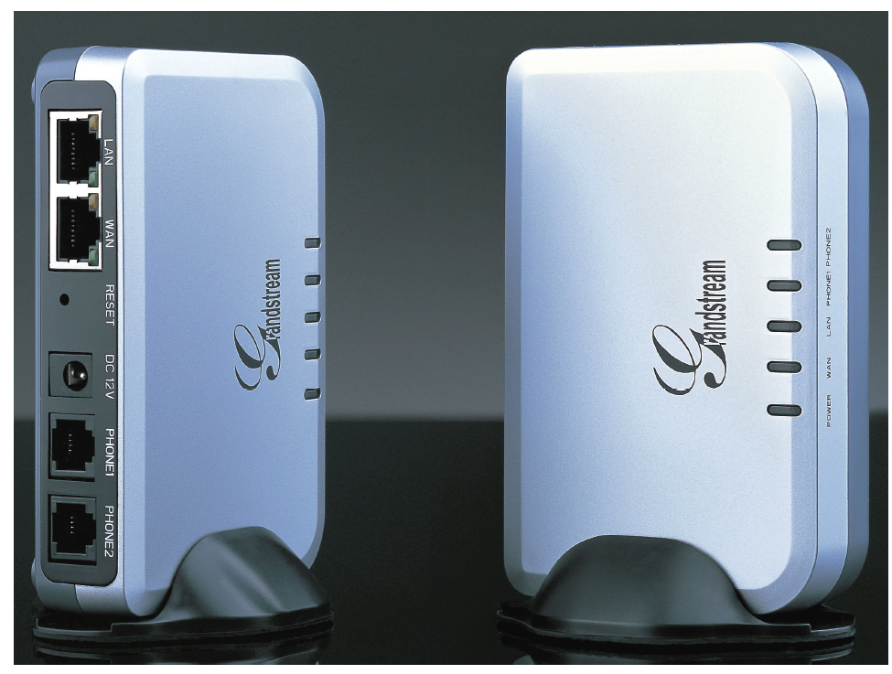
Figure 12-1 ATA (analog telephone adapter)
Courtesy of Grandstream Networks, Inc.

Slide 10
Analog Telephones (cont’d.)
Alternate analog-to-digital conversion method
Connect analog telephone line to switch, router, or gateway
Convert analog voice signals into packet
Issue packet to data network
Vice versa

Slide 11
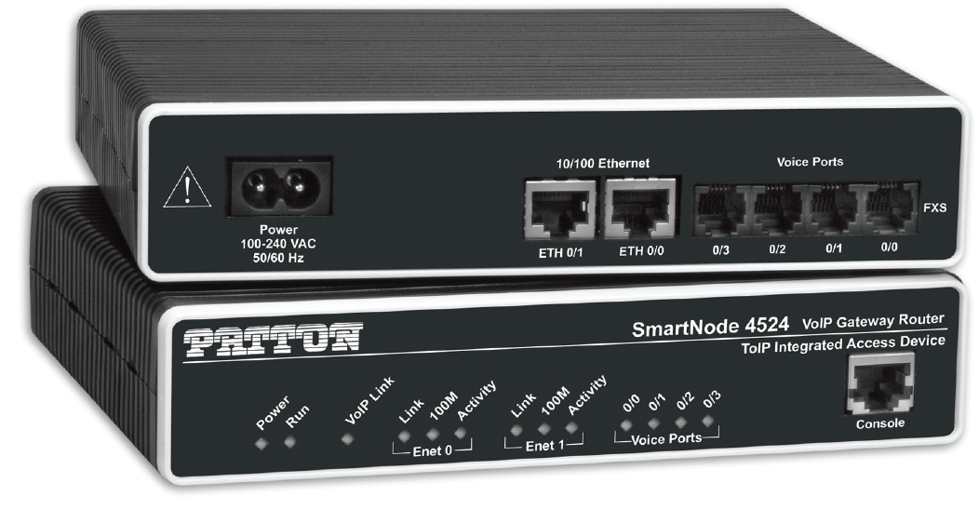
Figure 12-2 VoIP router
Photo of SmartNode™4520 Analog VoIP router from Patton Electronics , Co.

Slide 12
Analog Telephones (cont’d.)
Digital PBX (private branch exchange)
More commonly called IP-PBX
Telephone switch connecting and managing calls within private organization
Accepts, interprets analog and digital voice signals
Connects with traditional PSTN lines, data networks
Transmits, receives IP-based voice signals to and from other network connectivity devices
Packaged with sophisticated software

Slide 13
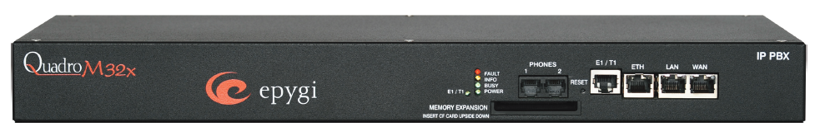
Figure 12-3 IP-PBX
Courtesy of Epygi Technologies, Ltd.

Slide 14
Analog Telephones (cont’d.)
Hosted PBX
Exists on the Internet
Separate provider for call management services
May also be called virtual PBXs
Trademark of VirtualPBX company
Advantage of Hosted PBXs
No installation or maintenance of hardware and software for call completion and management

Slide 15
Analog Telephones (cont’d.)
Traditional telephone connects to analog PBX
Then connects to voice-data gateway
Gateway connects traditional telephone circuits with TCP/IP network
Internet or private WAN
Gateway actions
Digitizes incoming analog voice signal
Compresses data
Assembles data into packets
Issues packets to packet-switched network

Slide 16
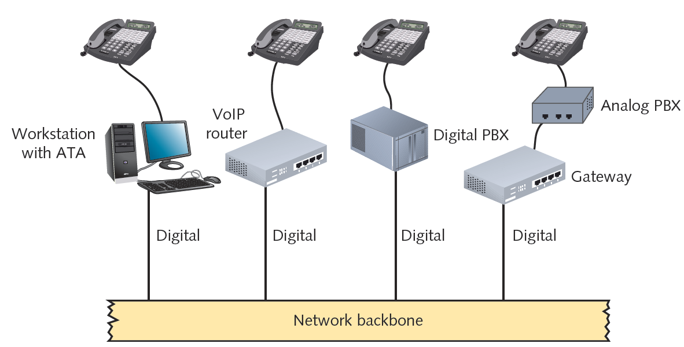
Figure 12-4 Integrating VoIP networks and analog telephones
Courtesy of Course Technology/Cengage Learning

Slide 17
IP Telephones
IP telephones (IP phones)
Transmit, receive only digital signals
Voice immediately digitized, issued to network in packet form
Requires unique IP address
Looks like traditional touch-tone phone
Connects to RJ-45 wall jack
Connection may pass through connectivity device before reaching IP-PBX

Slide 18
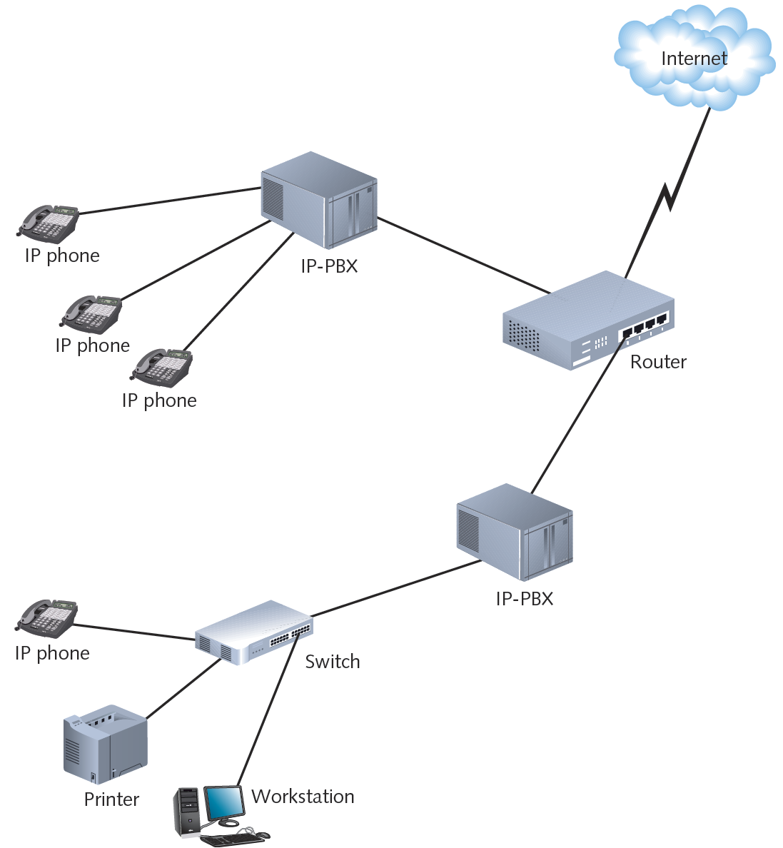
Figure 12-5 Accessing a VoIP network from IP phones
Courtesy of Course Technology/Cengage Learning

Slide 19
IP Telephones (cont’d.)
IP telephone features
Speed-dialing
Call hold
Transfer, forward
Conference calling
Voice-mail access
Speakers, microphones, LCD screen
Mobile and wired styles
Some can act as Web browsers
Easily moved from office to office

Slide 20
IP Telephones (cont’d.)
Conventional analog telephone
Obtains current from local loop
Current used for signaling (ring, dial tone)
IP telephones
Need electric current
Not directly connected to local loop
Most use separate power supply
Susceptible to power outages
Requires assured backup power sources
Some use PoE (power over Ethernet)

Slide 21
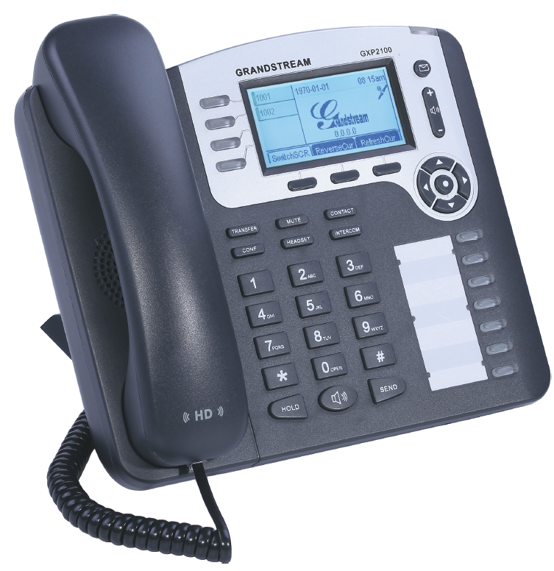
Figure 12-6 An IP phone
Courtesy of Grandstream Networks, Inc.

Slide 22
Softphones
Computer programmed to act like IP telephone
Provide same calling functions
Connect to network; deliver services differently
Prerequisites
Computer minimum hardware requirements
IP telephony client installed
Digital telephone switch communication
Full-duplex sound card
Microphone, speakers
Softphone example: Skype

Slide 23
Softphones (cont’d.)
Graphical interface
Presented after user starts softphone client software
Customizable
Versatile connectivity
VoIP solution for traveling employees and telecommuters
Convenient, localized call management
Call tracking
Date, time, duration, originating number, caller names
Simplifies recordkeeping and billing

Slide 24
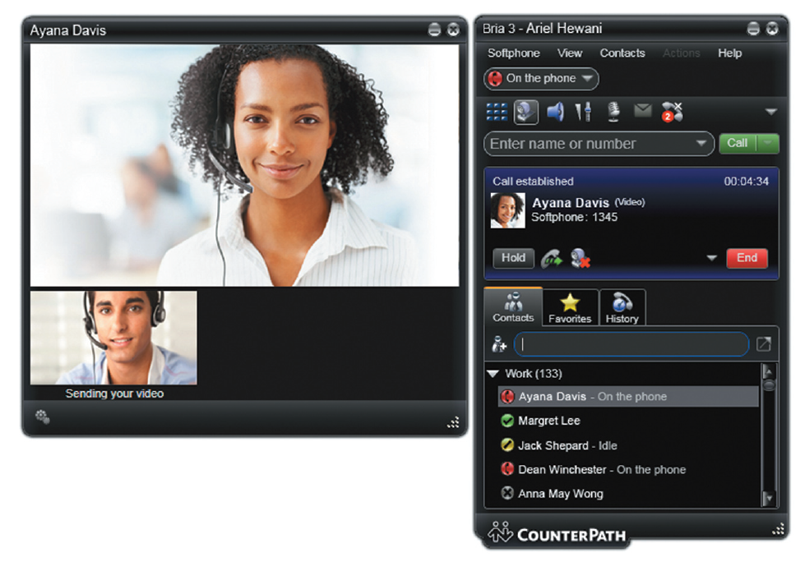
Figure 12-7 Softphone interface
Courtesy of CounterPath Corporation

Slide 25
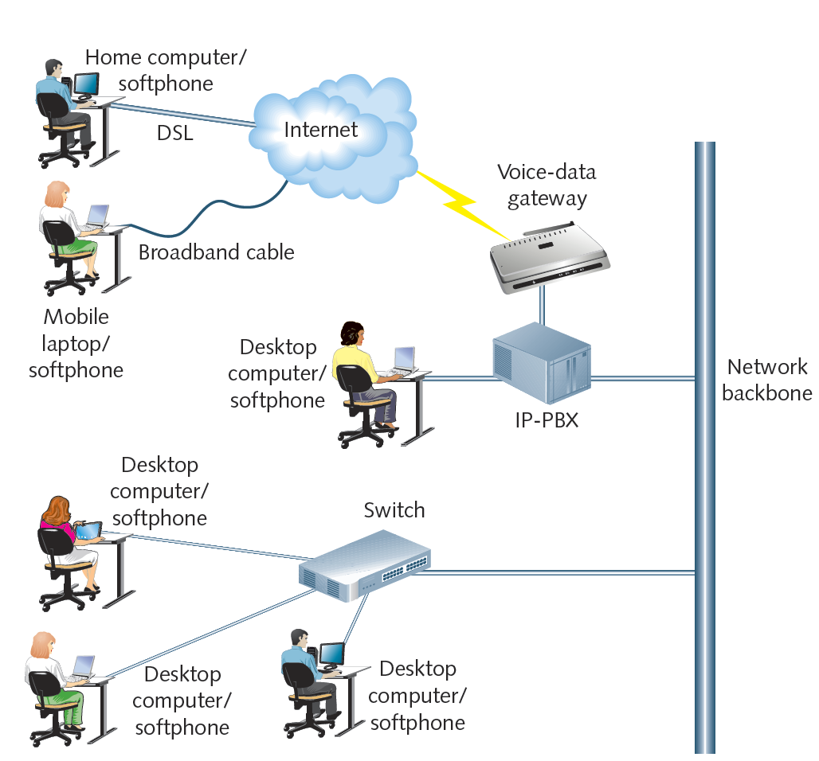
Figure 12-8 Connecting softphones to a converged network
Courtesy of Course Technology/Cengage Learning

Slide 26
Video-over-IP Applications and Interfaces
Cisco Systems estimate
By 2015, over two-thirds of Internet traffic will be video traffic
Factors fueling growth
Large quantity of video content available
Increasing number of devices accessing Internet
Decreasing cost of bandwidth, equipment
Video-over-IP services categories
Streaming video, IPTV, videoconferencing

Slide 27
Streaming Video
Simplest among video-over-IP applications
Basic computer hardware, software requirements
Video-on-demand
Files stored on video streaming server
Popular
Viewer chooses video when convenient
Views using Web browser
Streaming video can be issued live
From source directly to user

Slide 28
Streaming Video (cont’d.)
Drawbacks of live stream
Content may not be edited before distribution
Viewers must connect with stream when issued
Video-on-demand benefits
Content viewed at user’s convenience
Viewers control viewing experience
Pause, rewind, fast-forward capabilities

Slide 29
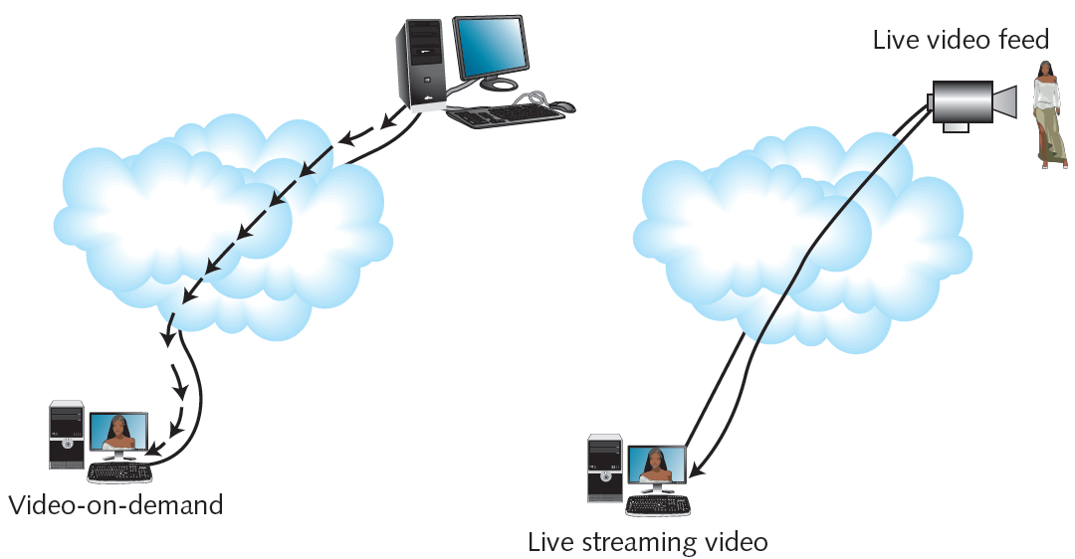
Figure 12-9 Video-on-demand and live streaming video
Courtesy of Course Technology/Cengage Learning

Slide 30
Streaming Video (cont’d.)
Consider number of clients receiving each service
Point-to-point video over IP
Point-to-multipoint video over IP
Not the same as multicast transmission
Unicast transmissions
Single node issues data stream to one other node
Example: CSPAN source issues signals to each viewer
Network classification: public or private
Most streaming video occurs over public networks

Slide 31
IPTV (IP Television)
Telecommunications carrier, cable company networks
High-bandwidth Internet connections
IPTV digital television signals
Digital video valued as an added service
Investing money into hardware, software
Elements of delivering digital video to consumers
Telco accepts video content at a head end
Telco’s CO (central office) servers provide management services
Video channel assigned to multicast group

Slide 32
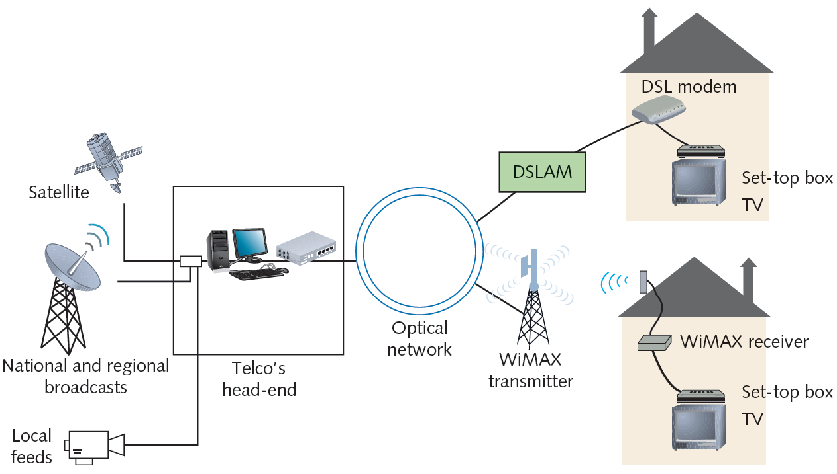
Figure 12-10 A telecommunications carrier’s IPTV network
Courtesy of Course Technology/Cengage Learning

Slide 33
IPTV (cont’d.)
IPTV multicasting advantages
Simple content delivery management
Issue one multicast transmission to entire group
Local loop capacity issues
Most rely on copper to home (limits throughput)
Overwhelming local loop
Solution: Telco transmits only content ordered
IGMP (Internet Group Management Protocol)
Manages multicasting
Routers communicate using multicast routing protocol

Slide 34
IPTV (cont’d.)
Compressed, digital video signal travels like data signal
DSL, WIMAX
Advantage of delivering video over telcom or cable network
Company controls connection end to end
Can monitor and adjust QoS (quality of service)

Slide 35
Videoconferencing
Unidirectional video-over-IP services
Video delivered to user who only watches content
Videoconferencing
Full-duplex connections
Participants send, receive audiovisual signals
Real time
Benefits
Cost savings, convenience
Replace face-to-face business meetings
Allow collaboration

Slide 36
Videoconferencing (cont’d.)
Videoconferencing uses
Telemedicine
Tele-education
Judicial proceedings
Surveillance
Hardware, software requirements
Means to generate, send, receive audiovisual signals
Computer workstation with cameras, microphones, software
Video terminal or video phone

Slide 37
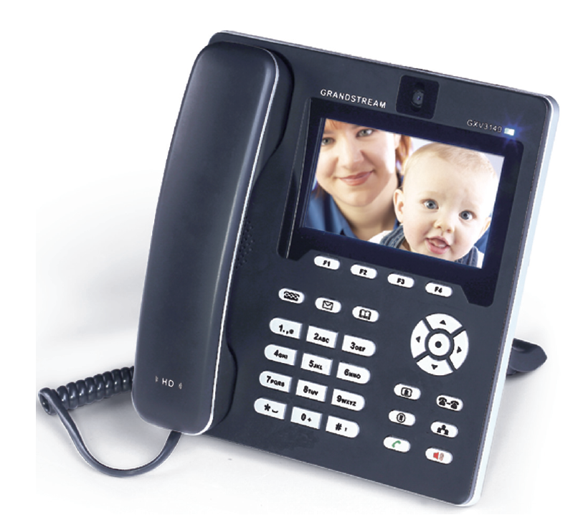
Figure 12-12 Videophone
Courtesy of Grandstream Networks

Slide 38
Videoconferencing (cont’d.)
Video bridge
Manages multiple audiovisual sessions
Participants can see, hear each other
Conference server
Hardware or software
Leased Internet-accessible video bridging services
Occasional videoconference use
Video bridge depends on signaling protocols

Slide 39
Signaling Protocols
Signaling
Information exchange between network components, system
Establishing, monitoring, releasing connections
Controlling system operations
Signaling protocols
Set up, manage client sessions
Perform several functions
Early VoIP: proprietary signaling protocols
Today: standardized signaling protocols

Slide 40
H.323
ITU standard describing architecture, protocols
Establishing, managing packet-switched network multimedia sessions
Supports voice, video-over-IP services
Terms
H.323 terminal
H.323 gateway
H.323 gatekeeper
MCU (multipoint control unit)
H.323 zone

Slide 41
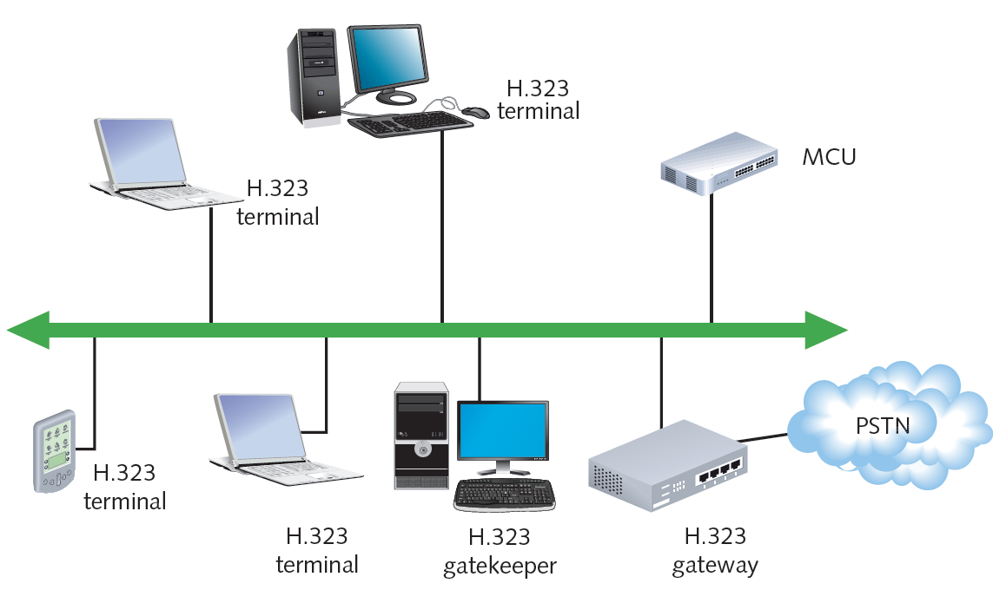
Figure 12-13 An H.323 zone
Courtesy of Course Technology/Cengage Learning

Slide 42
H.323 (cont’d.)
H.225 and H.245 signaling protocols
Specified in H.323 standard
Operate at Session layer
H.225 handles call or videoconference signaling
H.245 ensures correct information type formatting
Uses logical channels
H.323 standard
Specifies protocol interoperability
Presentation layer: coding, decoding signals
Transport layer

Slide 43
H.323 (cont’d.)
Codified in 1996
Early version suffered slow call setup
Revised several times
Remains popular signaling protocol
Large voice and video networks

Slide 44
SIP (Session Initiation Protocol)
Application layer signaling, multiservice control protocol, packet-based networks
Performs similar functions as H.323
Modeled on HTTP
Reuse existing TCP/IP protocols
Session management, enhanced services
Modular and specific
Limited capabilities compared to H.323
Example: no caller ID

Slide 45
SIP (cont’d.)
SIP network components
User agent
User agent client
User agent server
Registrar server
Proxy server
Redirect server

Slide 46
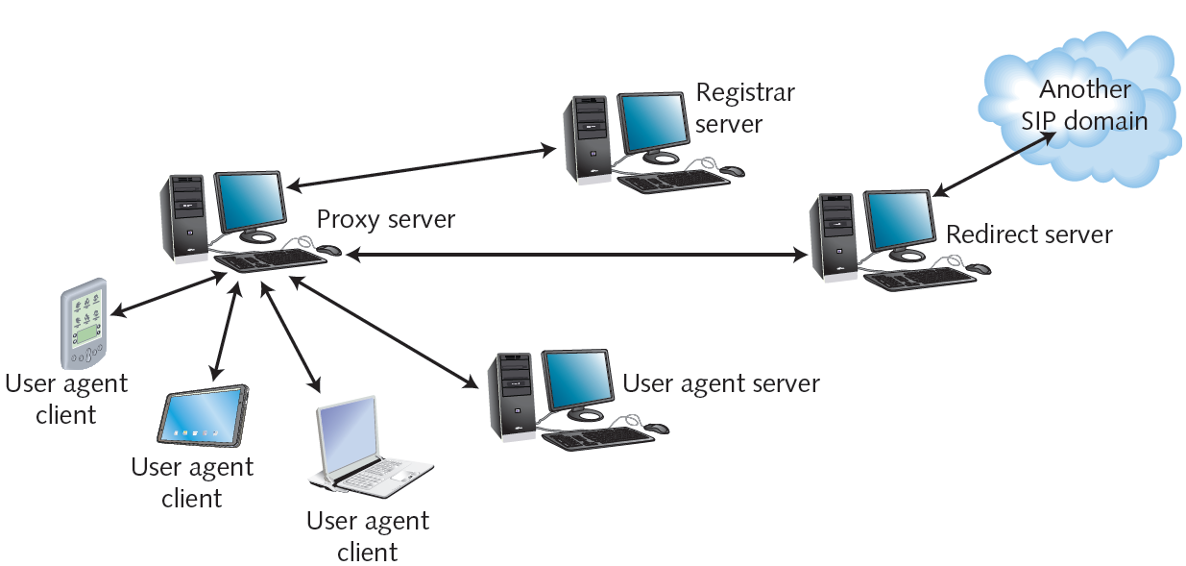
Figure 12-14 An H.323 zone
Courtesy of Course Technology/Cengage Learning

Slide 47
SIP (cont’d.)
Advantages of SIP over H.323
Simplicity
Fewer instructions to control call
Consumes fewer processing resources
More flexible
SIP and H.323
Regulate call signaling, control for VoIP or video-over-IP clients and servers
Do not account for communication between media gateways

Slide 48
MGCP (Media Gateway Control Protocol) and MEGACO (H.248)
Media gateway
Accepts PSTN lines
Converts analog signals into VoIP format
Translates between different signaling protocols
Information uses different channels than control signals
Also different logical and physical paths
Expedites information handling
Gateways still need to exchange and translate signaling and control information

Slide 49
MGCP and MEGACO (cont’d.)
MGC (media gateway controller)
Computer managing multiple media gateways
Facilitates exchange of call signaling information
Also called a softswitch
Advantageous on large VoIP networks
MGCP (Media Gateway Control Protocol)
Used on multiservice networks supporting many media gateways
Operate with H.323 or SIP
Older protocol

Slide 50
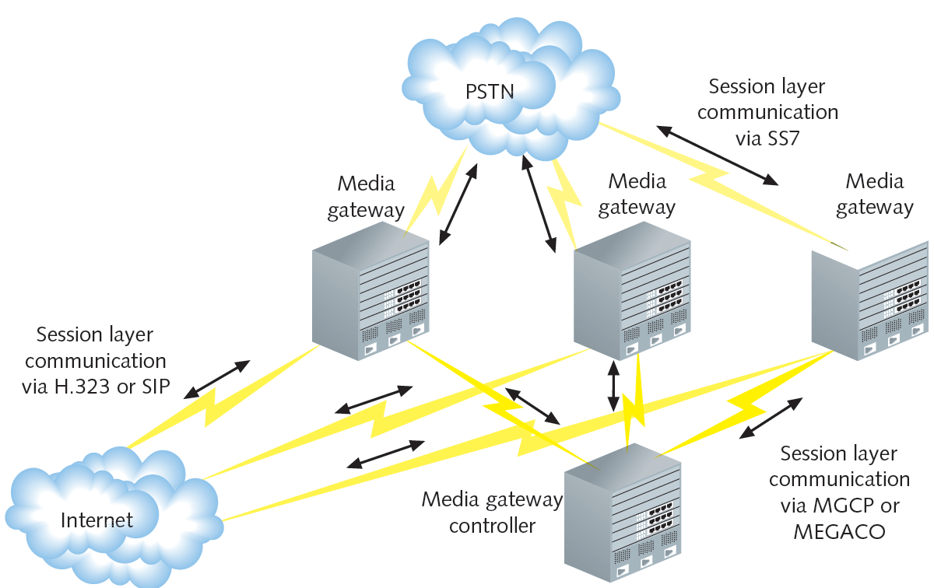
Figure 12-15 Use of an MGC (media gateway controller)
Courtesy of Course Technology/Cengage Learning

Slide 51
MGCP and MEGACO (cont’d.)
MEGACO
Newer protocol
Performs same functions as MGC
Different commands and processes
Operates with H.323 or SIP
Superior to MGCP
Supports ATM
Developed by ITU and IETF

Slide 52
Transport Protocols
MEGACO, MGC
Communicate information about voice, video session
Different protocol set delivers voice or video payload
Transport layer
Transport layer protocols
TCP: connection oriented protocol
Delivery guarantees
UDP: connectionless protocol
No accountability; preferred for real-time applications
Packet loss tolerable if additional protocols overcome UDP shortcomings

Slide 53
RTP (Real-time Transport Protocol)
Operates at Application layer
Relies on UDP at the Transport layer
Applies sequence numbers to indicate:
Destination packet assembly order
Packet loss during transmission
Assigns packet timestamp
Receiving node
Compensates for network delay
Synchronizes signals
No mechanism to detect success

Slide 54
RTCP (Real-time Transport Control Protocol)
Provides quality feedback to participants
Packets transmitted periodically
RTCP allows for several message types
RTCP value
Depends on clients’, applications’ information use
Not mandatory on RTP networks
RTP and RTCP
Provide information about packet order, loss, delay
Cannot correct transmission flaws

Slide 55
QoS (Quality of Service) Assurance
VoIP, video over IP transmission difficulty
Caused by connection’s inconsistent QoS
Preventing delays, disorder, distortion
Requires more dedicated bandwidth
Requires techniques ensuring high QoS
QoS measures network service performance
High QoS: uninterrupted, accurate, faithful reproduction
Improvements to QoS made in recent years
Service quality now comparable to PSTN, cable TV

Slide 56
RSVP (Resource Reservation Protocol)
Transport layer protocol
Reserves network resources prior to transmission
Creates path between sender, receiver
Provides sufficient bandwidth
Signal arrives without delay
Issues PATH statement via RSVP to receiving node
Indicates required bandwidth, expected service level
Two service types
Guaranteed service
Controlled-load service

Slide 57
RSVP (cont’d.)
Router marks transmission’s path
Routers issue PATH message
Destination router issues Reservation Request (RESV) message
Follows same path in reverse
Reiterates information
Routers allocate requested bandwidth
Sending node transmits data

Slide 58
RSVP (cont’d.)
RSVP messaging separate from data transmission
Does not modify packets
Specifies and manages unidirectional transmission
Resource reservation process takes place in both directions
RSVP emulates circuit-switched path
Provides excellent QoS
Drawback: high overhead
Acceptable on small networks
Larger networks use streamlined techniques: DiffServ

Slide 59
DiffServ (Differentiated Service)
Addresses QoS issues through traffic prioritization
Differs from RSVP
Modifies actual IP datagram
Accounts for all network traffic
Can assign different streams different priorities
To prioritize traffic
IPv4 datagram: DiffServ field
IPv6 datagram: Traffic Class field

Slide 60
DiffServ (cont’d.)
Two forwarding types
EF (Expedited Forwarding)
Data stream assigned minimum departure rate
Circumvents delays
AF (Assured Forwarding)
Data streams assigned different router resource levels
Prioritizes data handling
No guarantee of on time, in sequence packet arrival

Slide 61
MPLS (Multiprotocol Label Switching)
Modifies data streams at Network layer
Replaces IP datagram header with label:
At first router data stream encounters
Next router revises label
Label contains packet forwarding information
Considers network congestion
Very fast forwarding
Destination IP address compared to routing tables
Forward data to closest matching node

Slide 62
Summary
VoIP services carry voice signals over TCP/IP protocol
Four ways to connect VoIP clients to IP networks
Streaming video can be delivered live or on-demand
IPTV television signals travel over packet-switched connections
Video bridges manage communication for videoconferences
H.323 standard
Describes architecture and protocols for managing multimedia sessions on a packet-switched network

